Slide 1


Human Population Genetics Workshop 2025
Introduction to Polygenic Risk Scores (PRS)
Presenter: Carene NDONG SIMA

Slide 2
Lecture Objectives
Understand the concept of genetic risk
Define and explain polygenic risk scores (PRS)
Describe the computation of PRS
Discuss the Applications of PRS
Evaluate the Limitations and Challenges of PRS
Explore Future Directions in PRS research

Slide 3
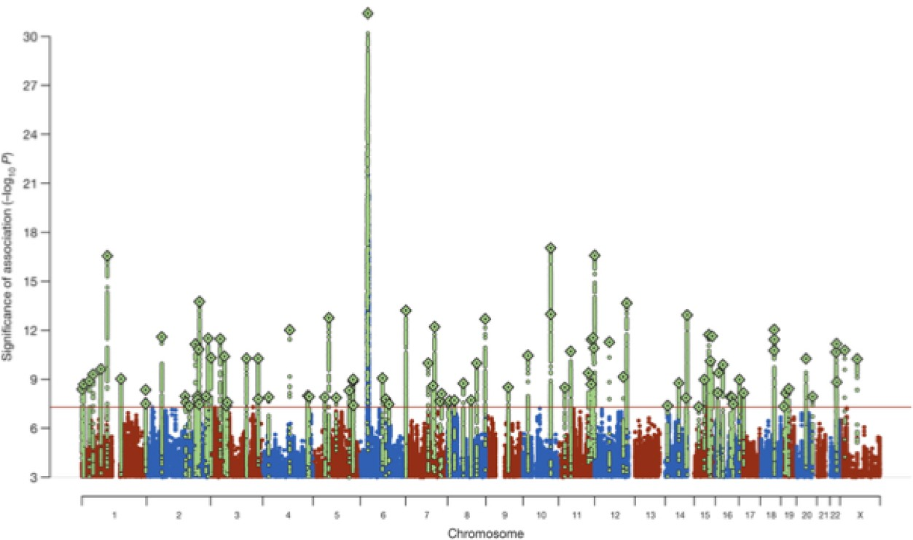
GWAS results as our starting point
Notes:
GWAS have been successful at identifying common SNPs associated with common complex diseases.
Although significant associations have been found, each SNP on its own has a small effect on disease outcome. This could be explained by the common-disease-common-variant (CDCV) hypothesis which states that if a disease is common in a population (prevalence > 1-5%), then its genetic contributors will also be common in that population with small individual effect size.
Therefore, trait/disease outcome is believed to be due to the cumulative effect of multiple variants.
These effects can then be combined into a score which ideally will summarize an individual’s genetic predisposition to that disease.
This is referred to as polygenic risk score or PRS....And provide an attractive venue for precision medicine in healthcare systems.

Slide 4
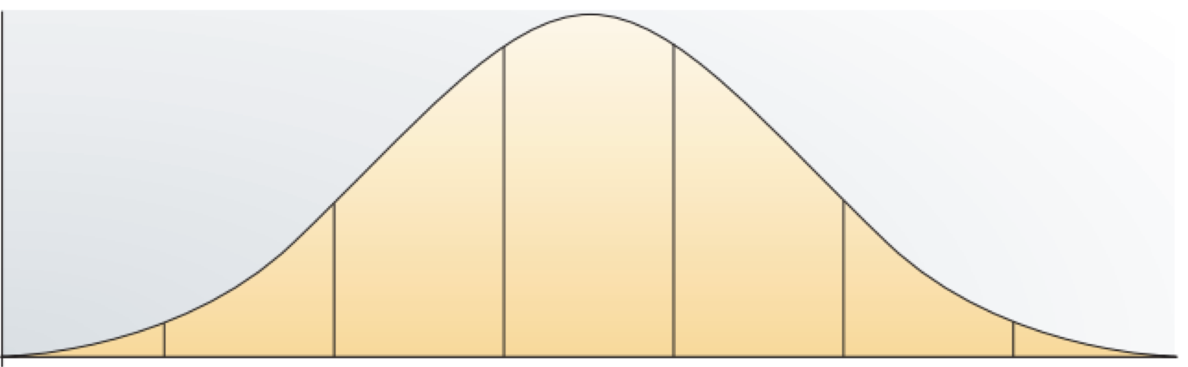


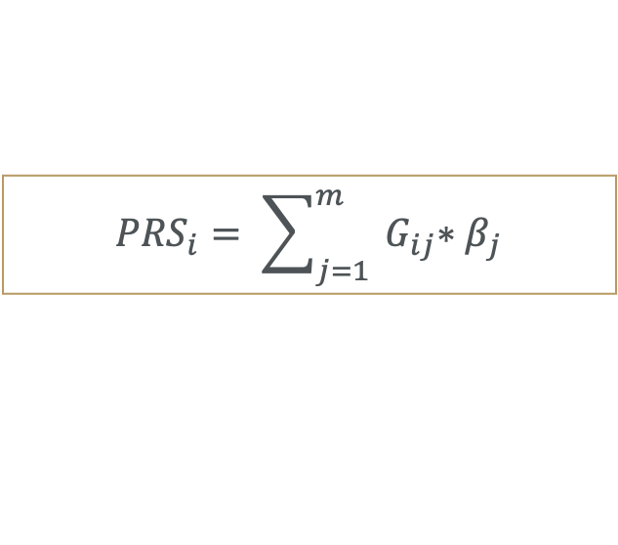
What is a Polygenic Risk Score? And how is it calculated?
PRS is a numerical estimate of an individual’s genetic predisposition to a trait or disease
It is calculated by summing the effects of many SNPs across the genome
${PRS}_{i}= \sum_{j=1}^{m}{{ G}_{ij}{∗β}_{j}}$
Notes:
A PRS is a numerical estimate of an individual’s genetic predisposition to a trait or disease.
and is calculated as the sum of an individual’s risk alleles, weighted by their effect sizes. Where the PRS of individual (i) is the sum of the genotype dosage (G) for each SNP (j to m) multiplied by the effect beta (j) for that allele.
Ideally, they could be used to stratify individuals based on their relative risk of developing a disease of interest.
For example, a high PRS for coronary artery disease suggests a higher likelihood of developing heart disease, potentially guiding early preventive measures.

Slide 5
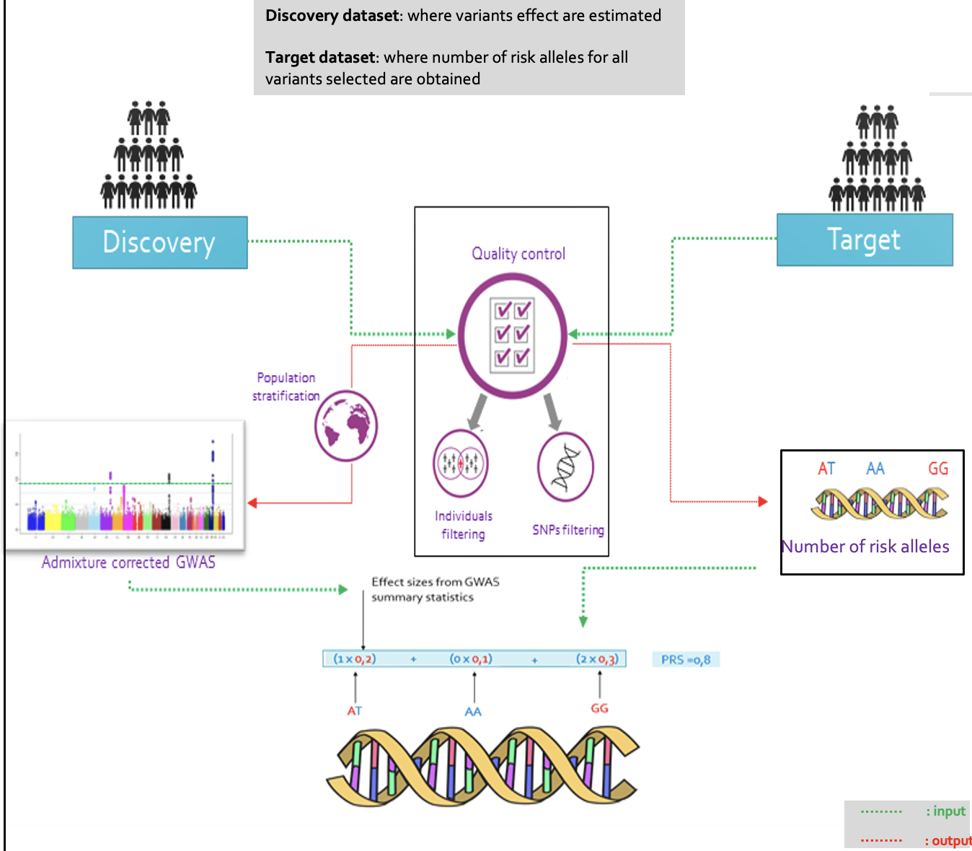
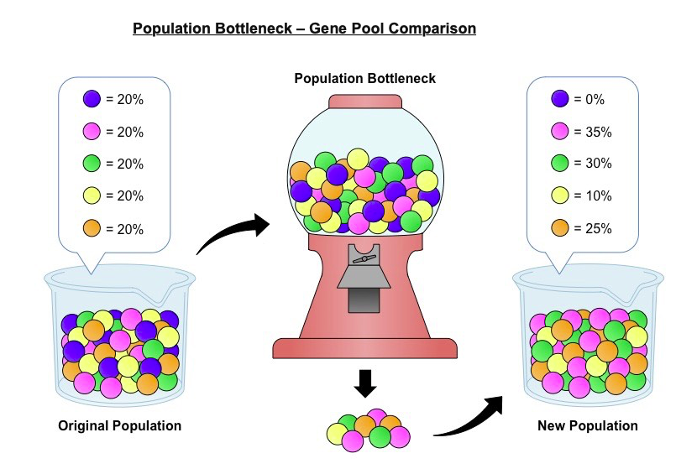
What is required for calculation?
Notes:
For PRS calculations, two input datasets are usually required: (i) a discovery dataset (i.e., GWAS summary statistics), from which SNPs and their subsequent effect sizes are obtained and (ii) a target dataset (i.e., cohort understudy), from which genotype dosage of each SNP included in the calculation are obtained. PRS is then calculated for each individual in the target dataset, as per the previous equation. PRS analyses can be divided into two main steps. The first step involves quality control of discovery and target data, and the second is the calculation of the scores.

Slide 6
Visual Representation of PRS calculation: a practical example using 3 SNPs
Discovery data (GWAS summary stats)
Target data (your study dataset)
 | Effect size = beta | Risk Allele
SNP1 | 0,2 | A
SNP2 | -0,3 | T
SNP3 | 0,1 | G
Individual | SNP1 | SNP2 | SNP3
1 | AT | AA | GC
2 | AA | TA | GG
3 | TT | TA | GC
PRS calculation
Individual | SNP1 | SNP2 | SNP3 | PRS
1 | (0,2 x 1 A) + (0,2 x 0 A) | (-0,3 x 0 T) + (-0,3 x 0 T) | ( 0,1 x 0 G) + ( 0,1 x 1 G ) | 0,2 + 0 + 0,1 = 0,3
2
3
Notes:
Here is a simple table where different SNPs contribute varying amounts to the total PRS.

Slide 7
Calculation of PRS
Use of SNPs? Which SNPs?
Betas or adjusted betas?
What about LD between SNPs
PRS units?

Slide 8
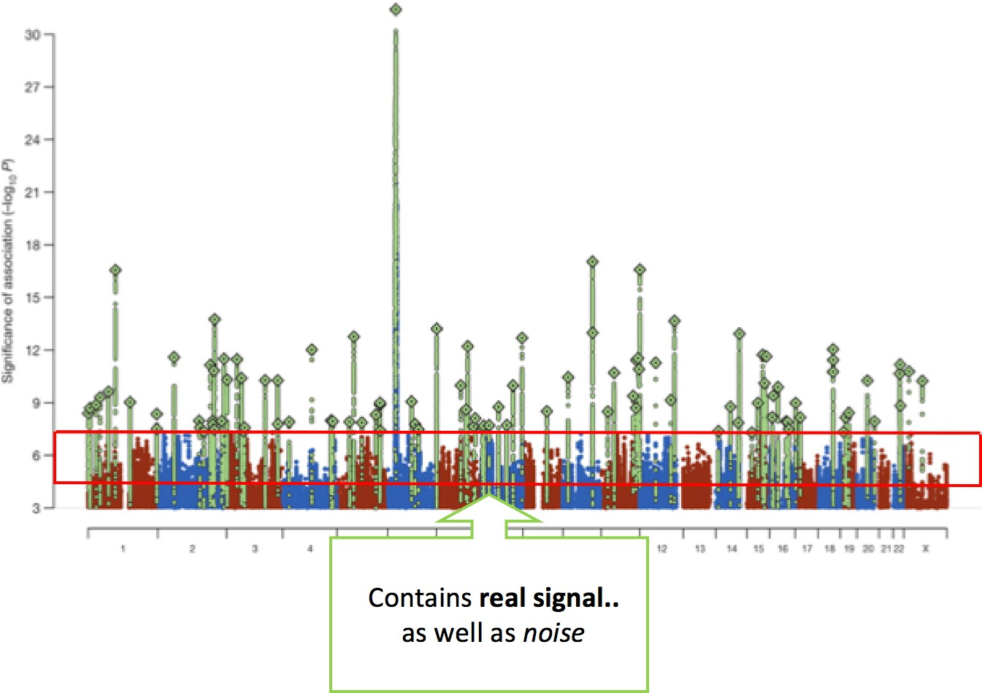
SNP inclusion: the more the merrier?
Key concepts for PRS: Including non-
significant SNPs may increase predictive
power
Notes:
A PRS is the weighted sum of an individual’s risk alleles for a given trait and ideally, all the SNPs should be summed across all loci. However, there are two factors to consider:
many GWAS are underpowered, which means that there could be more true associations than those discovered (i.e., those reaching genome-wide significance);
the inherent issue of linkage disequilibrium (LD), which creates a correlation structure among nearby variants and can, therefore, inflate the PRSs and result in poor generalizability across populations

Slide 9
Controlling for Linkage Disequilibrium (LD)
IDEAL: full conditional analysis performed and only SNPs that best capture the signal of causal variants retained
The standard approach ‘controls’ for LD via clumping
Clumping thins down the SNP set - retaining most associated SNPs - so that those remaining are ∼independent
Some approaches include all SNPs and adjust for LD (e.g., Bayesian approach, Frequentist regression etc)

Slide 10
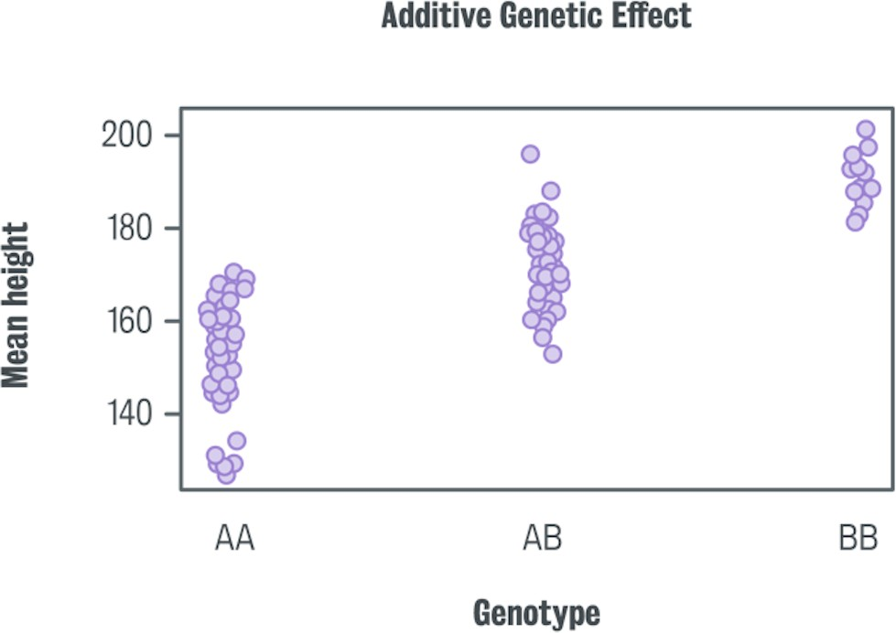
PRS units
What units should PRS be measured in?
Notes:
PRS does not have a unit in the conventional sense
Since a polygenic risk score is a dimensionless quantity derived from a statistical analysis of genetic data, it does not have a physical unit like meters or kilograms. Instead, it represents the cumulative genetic risk based on the specific genetic variants and the weights assigned to them during the calculation process.

Slide 11
PRS performance assessment
Test is PRS is associated with phenotype of interest
Notes:
Metrics commonly used to evaluate a PRS include the pseudo-R², which indicates the amount of phenotypic variance explained by the PRS (Lee et al., 2012), the Brier score, and the area under the ROC curve (AUC)

Slide 12

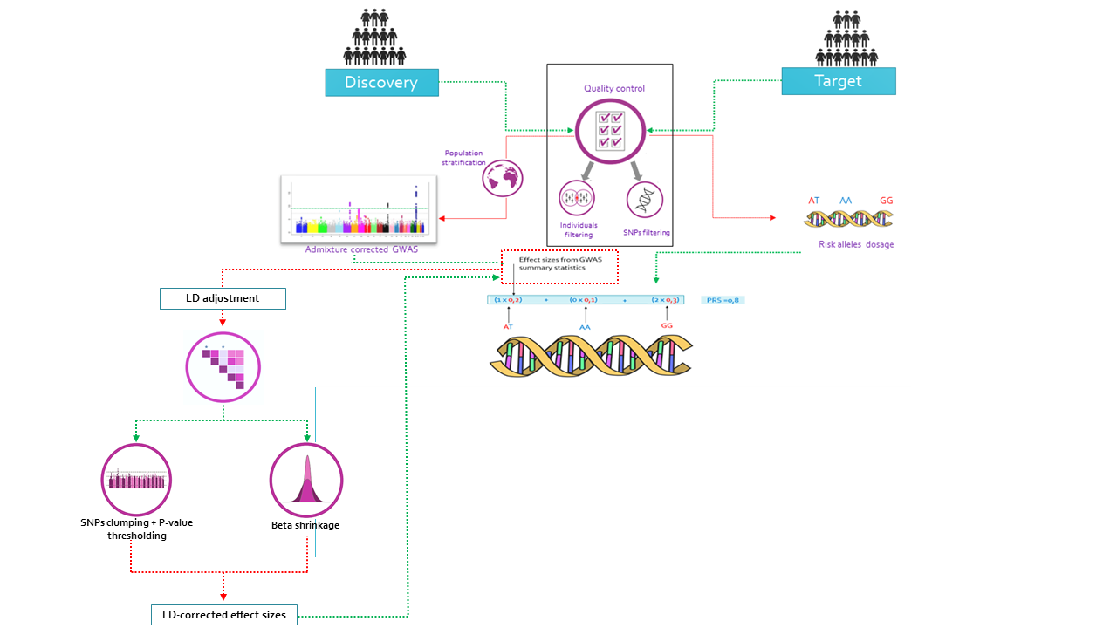



: input
Target
Validation set: used to optimise hyper-parameters for PRS tools that use a grid of parameters
Testing set: used to test the performance of PRS model
: output
Validation set (70%)
Testing set (30%)
Number of risk alleles
Model trained
PRS model performance assessment
Polygenic Risk Score
Model training
Low risk
High risk
PRS-TB association testing
Notes:
Now, to test if our PRS model could distinguish between cases and controls, we split the target dataset into 70% validation set and 30% testing set.
Where the validation set was used as the initial target dataset..
and the testing set served as an independent set to test the predictive performance of that model, in other word to test if that model can predict outcome with a certain level of certainty.

Slide 13
Applications of PRS
Predicting clinical risk for screening/prevention/intervention
Predicting genetic predisposition to actionable traits
Improving case/control classification (e.g., For clinical trials)
Detecting shared aetiology between phenotypes
Identifying genetic basis of symptoms
Testing for G*E interactions
Use in Mendelian Randomization (inferring causality)
Pathway analyses: providing individual pathway PRS
Notes:
PRS has various applications in healthcare and research:
Disease Risk Prediction: Individuals with high PRS may have increased risk and need proactive monitoring.
Personalized Medicine: PRS can guide targeted interventions and lifestyle recommendations.
Clinical Risk Stratification: PRS helps doctors decide who should receive more frequent screenings.
Example: Breast cancer screening guidelines could be adjusted based on PRS levels.

Slide 14
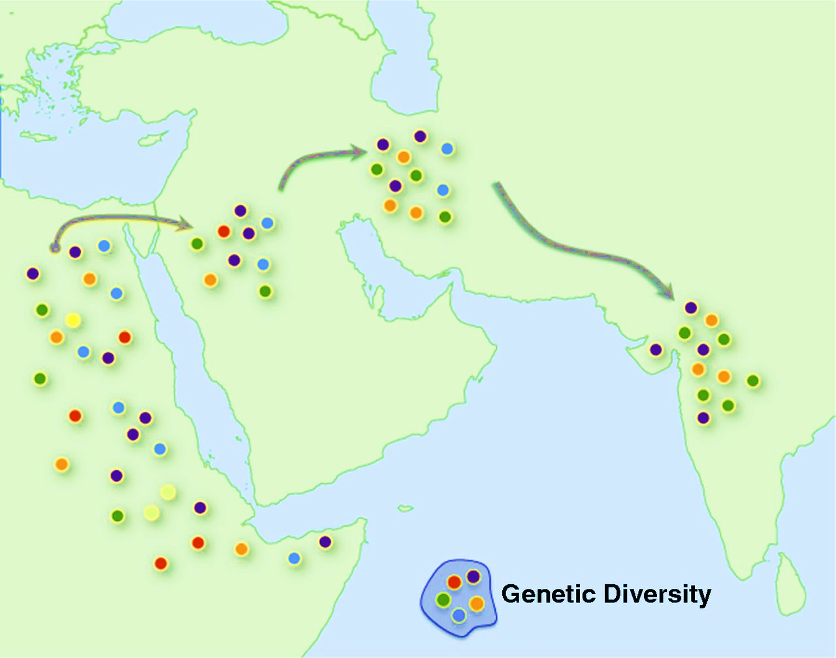
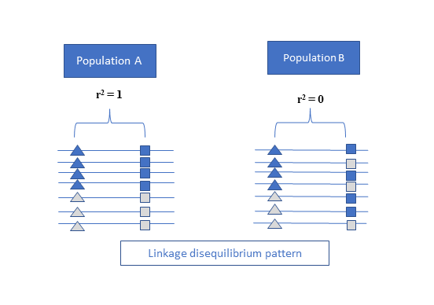
Limitations & Challenges
Under-representation of certain global groups
African ancestry
Admixed individuals
Non-portability of PRS due
Allele frequencies and LD
Population specific causal variants or effects
Gene-gene interactions
Gene-environment interactions
1
2
Pop A
in LD
Not in LD
Pop B
Genetic drift
= Causal variant
= tagging variant
Adapted from Henn B. M., et al (2012)
Notes:
There are several potential pitfalls in the construction of PRS that could affect how they perform in real-world clinical populations.
One of the most obvious is that they have mostly been explored in European populations and non-communicable diseases.
And it has been shown that PRS from European populations see a decrease in accuracy when applied to other populations, especially to African and admixed individuals.
And this has been attributed to not only genetic drift during the Out-of-Africa expansion.... Which resulted in differences in minor allele frequencies and LD patterns across and within populations.
But also, population specific causal variants as well as gene-gene and gene-environment interactions.
So, How does Linkage Disequilibrium affect PRS?
If we take population A, in figure 2, in which a variant is in perfect LD with a causal variant..therefore highly correlated with it. This variant would be strongly associated with the disease and probably have a high effect On disease risk in that population.
If we then introduce this variant’s effect in population B....where the same variant isn’t nearly as correlated with that disease.... PRS would be skewed and perform poorly.
This is especially true for admixed individuals who have inherited different LD patterns from different populations.

Slide 15
Future Directions
To improve PRS utility, we need more GWAS studies in diverse populations.
PRS should be integrated with non-genetic risk factors to enhance prediction accuracy.
Future research should also focus on clinical guidelines for incorporating PRS into routine healthcare.

Slide 16
Recommended reading
Dudbridge et al 2013. “Power and predictive accuracy of polygenic risk scores”. (https://journals.plos.org/plosgenetics/article?id=10.1371/journal.pgen.1003348 )
Choi et al 2020. “A guide to performing polygenic risk score analyses”. (https://doi.org/10.1101/416545)
Martin et al 2017. “Human demogrphic history impacts genetic risk prediction across diverse populations (https://pmc.ncbi.nlm.nih.gov/articles/PMC5384097/ )
Ndong Sima et al 2024. “Methodologies underpinning polygenic risk scores estimation: a comprehensive overview”. (https://pmc.ncbi.nlm.nih.gov/articles/PMC11522080/)

Slide 17

Thank you
Enkosi
Dankie
Photo by Stefan Els
Notes:
Cover & End Slide Option
Replace the background image: Right-click on the slide, then choose Format Background and select Picture or texture fill. Select a new picture of your choice.
Remember to add an image attribution for e.g., Photo by Stefan Els.

